Slide 1


Gastón Creci
07/03/2025
Disclaimer: this presentation is filled in from a template, following specific directions. If it was up to me, I wouldn’t clutter that much text and bullet points, and rather keep a simple style.

Slide 2

Outline
Executive Summary
Introduction
Methodology
Results
Conclusion
Appendix

Slide 3
Executive Summary
Summary of methodologies
Summary of all results

Slide 4
Introduction
Project background and context
Problems you want to find answers

Slide 5

Section 1

Slide 6
Methodology
Executive Summary
Data collection methodology:
Data is retrieved via SpaceX API and web scraping with BeatifulSoup, stored as a Dataframe, cleaned and specialized to the Falcon 9 launches.
Perform data wrangling
Data is cleaned, separated into numerical and categorical columns and classified according to the mission outcomes.
Perform exploratory data analysis (EDA) using visualization and SQL
Perform interactive visual analytics using Folium and Plotly Dash
Perform predictive analysis using classification models
How to build, tune, evaluate classification models

Slide 7
Data Collection
Data sets collected via
SpaceX API: JSON response
Web scraping: HTML response
Final pandas Dataframe with the parsed data

Slide 8
Data Collection – SpaceX API
After launching the SpaceX API, we extract the IDs of the rocket launches.
We use the IDs to extract the properties of each launch.
We build a Dataframe with the data and filter the Falcon 9 launches.
The file can be found here.
Launch SpaceX API
Use GET request
JSON response
Dataframe with IDs
Use API and IDs to parse and extract:
Booster Version
Launch Site
Payload
Core
Select Falcon 9 launches

Slide 9
Data Collection - Scraping
We use the Wikipedia page for Falcon 9 launches.
Using BeautifulSoup we parse the html and extract the relevant columns.
The file can be found here.
Web scraping
Use GET request from Falcon 9 Wikipedia
HTML response
BeautifulSoup object
Use html code to select tables, parse and extract:
Flight No - Orbit
Launch Site - Customer
Payload - Launch outcome
Payload mass - Booster Version
Booster landing outcome
Date - Time

Slide 10
Data Wrangling
First, we identify missing values in the landing pad column, as well as identify data types.
Afterwards, we explore the launches sites and orbit types of each launch, and find that most of the rockets are launched at CCAFS SLC 40, and to a GTO orbit.
Using the outcomes, we identify the successful and unsuccessful landings, and transform their values into numerical Booleans (0/1) for feature engineering.
The file can be found here
EDA:
Identify missing values
EDA:
launch sites and orbits
Training labels:
Outcomes
0
1

Slide 11
EDA with Data Visualization
We plotted the following relationships due to their possible correlation with the landing outcome:
Payload mass, launch site, and flight number.
Success rate, orbit type, payload mass, and flight number.
Launch success yearly trend.
The file can be found here

Slide 12
EDA with SQL
The SQL queries we performed were to obtain:
The names of the unique launch sites.
5 records where launch sites begin with ‘CCA’
The total payload mass carried by boosters launched by NASA (CRS)
The average payload mass carried by booster version F9 v1.1.
The date when the first successful landing outcome in a ground pad was archived.
The names of the boosters which succeeded in a drone ship and have a payload mass between 4 and 6 tones.
Total number of successful and failure mission outcomes
The names of the booster versions that carried the maximum payload mass
The month names, failure landing outcomes in a drone shup, booster versions and launch sites for the year 2015.
The ranked count of landing outcomes between the data 04/06/2010 and 20/03/2017.
The file can be found here

Slide 13
Build an Interactive Map with Folium
We created a Folium map centered at NASA Johnson Space Center (NJSC) at Houston, TX. Using the map objects circle and marker, we added a circle around NJSC and the other launch sites within the data set, and a label (marker) displaying the name of the site.
Within each launch, we added a marker cluster object to show the outcome of the landing (success/failure), indicated by the color in the customized icons.
Finally, we study the proximity of the launch sites to cities, railways, highways and costal lines by drawing a PolyLine and computing the distance to each item using MousePosition.
The file can be found here

Slide 14
Build a Dashboard with Plotly Dash
After selecting a launch site or all of them using a dropdown menu, we made a dashboard displaying:
Pie chart with total success landings corresponding to all sites
Pie chart with success rate specialized to a specific site.
Additionally, we plot the successes and failures for the different booster version categories, as a function of the payload mass, which range is controlled by a slider.
By studying these plots, we can study the optimum site launch, booster category version and payload mass in order to have a successful outcome.
The file can be found here

Slide 15
Predictive Analysis (Classification)
We identify the target variable as class, this is, the outcome of the landing.
After standardizing the data, we split it into train and test data, with the test size being a 20% of the total.
Then, we performed a grid search to look for the best parameters for:
Logistic regression
Support vector machine
And evaluated their scores via:
Accuracy on train data
Accuracy on test data
Confusion matric
The file can be found here
Decision tree
K-nearest neighbors

Slide 16
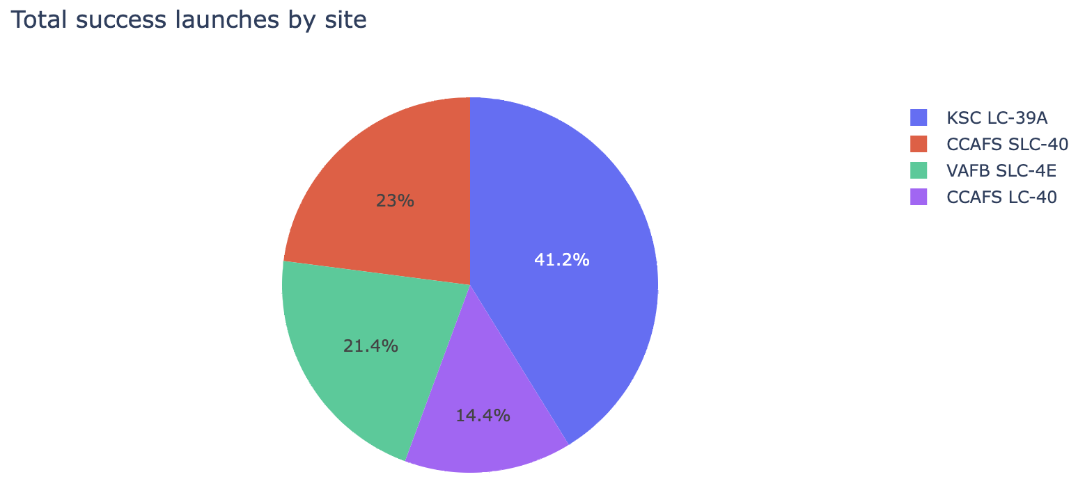
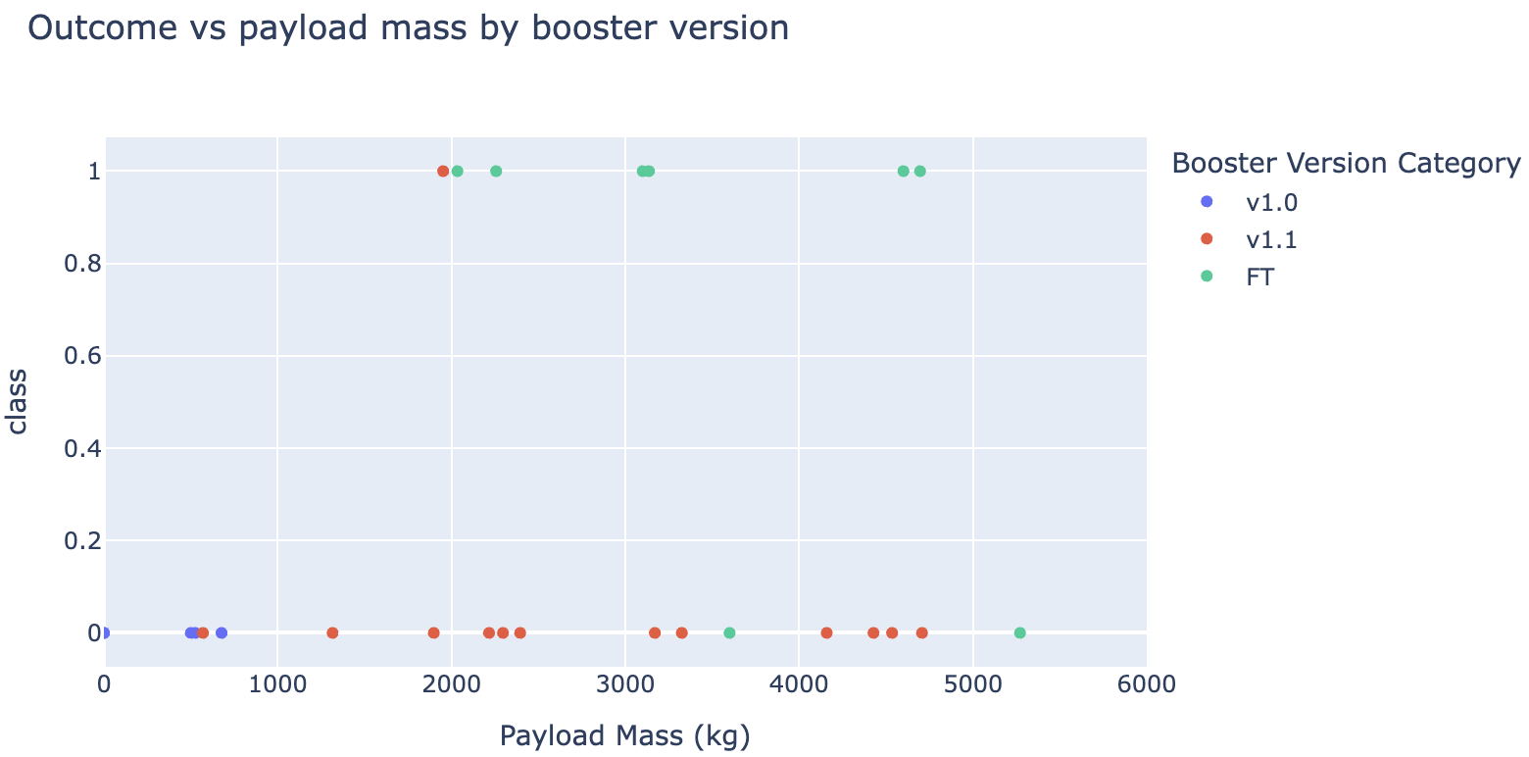
Results
EDA Visualization
The outcome is skewed within each launch site
Most of the failed launches are in CCAFS SLC 40
KSL LC 39A has the higher success rate
Launches with heavier payload masses are mostly successful
The most successful orbits are ES-L1, GEO, HEO and SSO.
The success in the LEO orbit seems to be related to the number of flights, although is not the case for the GTO orbit
Heavy payloads are more successful in the LEO, ISS and PO orbits.
The success rate has been increasing since 2013.
EDA SQL
Total payload mass carried by boosters launched by NASA (CRS) is 48213 Kg
The average payload mass carried by booster version F9 v1.1 is 2534.66 Kg
The first successful landing outcome in ground pad was archived on the 22/12/2015.
There is a total of 61 successful missions and 10 failed missions.
The most successful orbits are ES-L1, GEO, HEO and SSO.
The most landing outcomes are using a drone ship, and the least are the parachute landing.

Slide 17
Results
The predictive analysis revealed that the best model to predict the landing outcomes is a Decision Tree with:
Criterion: ‘gini’
Max_depth: 6
Max_features=‘sqrt’
Overall reaching the most accuracy of all models with a value of 0.88.
Min_samples_split: 10
Splitter: random

Slide 18

Section 2

Slide 19
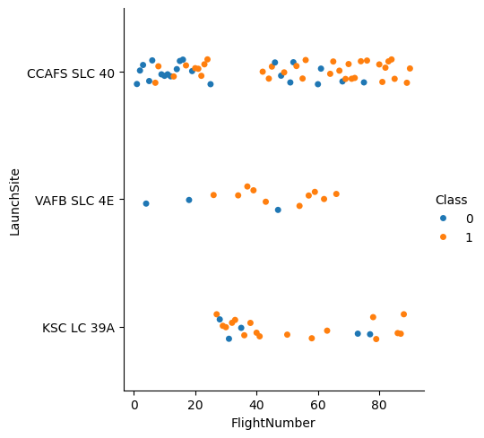
Flight Number vs. Launch Site
CCAFS SLC 40 has the greatest number of landing outcomes, with higher success rate towards higher number of flights.
VAFB SLC 4E has the least amount of data, with mostly successful landings.
KSC LC 39A has mostly successful landings, and higher number of flights than VAFB SLC 4E.

Slide 20
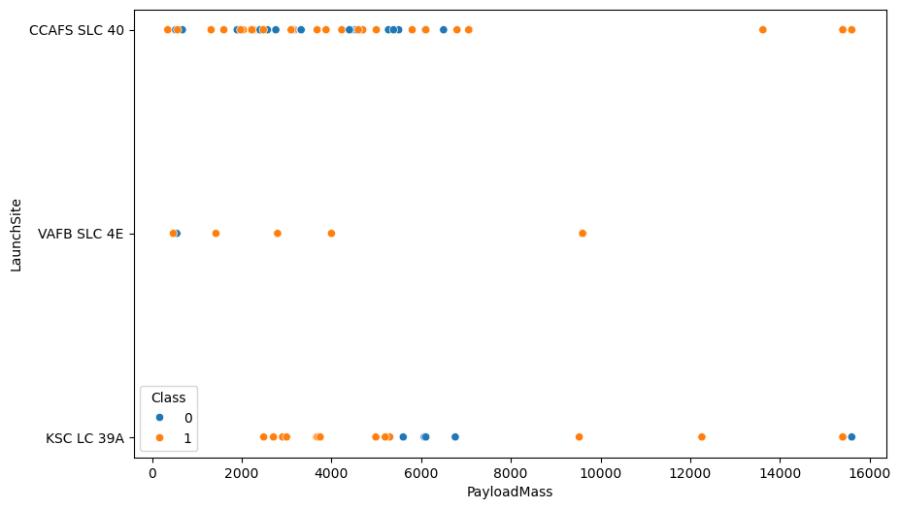
Payload vs. Launch Site
CCAFS SLC 40 has a payload mass distribution mostly between 0 and 8k with a few successful outliers between 12k and 16k.
VAFB SLC 4E successful landings increase with the payload mass.
KSC LC 39A has most successful landings for a payload mass lighter than 6k Kg, but no signs of an overall apparent distribution.

Slide 21
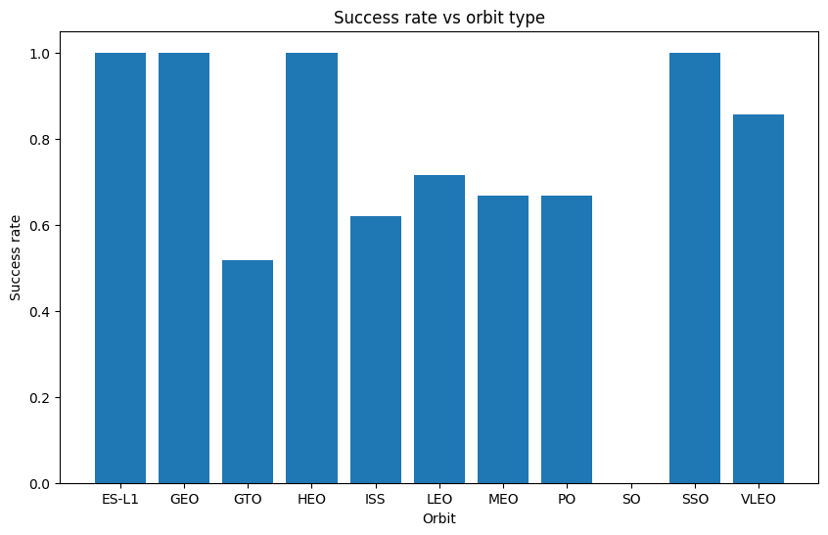
Success Rate vs. Orbit Type
The most successful orbits are:
ES-L1
GEO
HEO
SSO
The most unsuccessful one is SO.
We have to keep in mind that there is only one data point for the orbits HEO, ES-L1, SO and GEO.

Slide 22
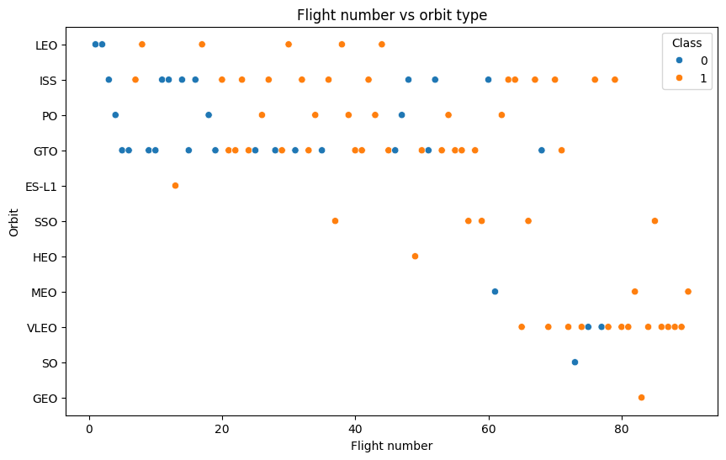
Flight Number vs. Orbit Type
For the LEO orbit, all landings are successful after more than 10 flights.
It seems to be a similar case for the SSO orbit.
The GTO orbit has the most data points, and it shows no relationship with the number of flights.
The VLEO orbit has mostly success landings as the number of flights increases, except for two flights.

Slide 23
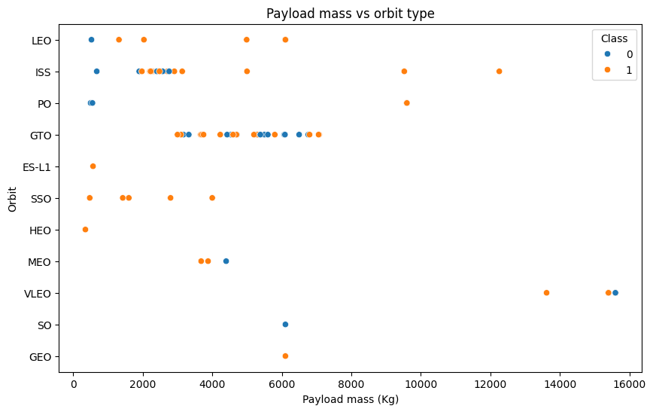
Payload vs. Orbit Type
Heavier loads result in a successful landing for the LEO, ISS and PO orbits
The SSO orbit has a 100% success rate for the payload masses under 5k Kg.
The GTO orbit does not seem to follow any trends.

Slide 24
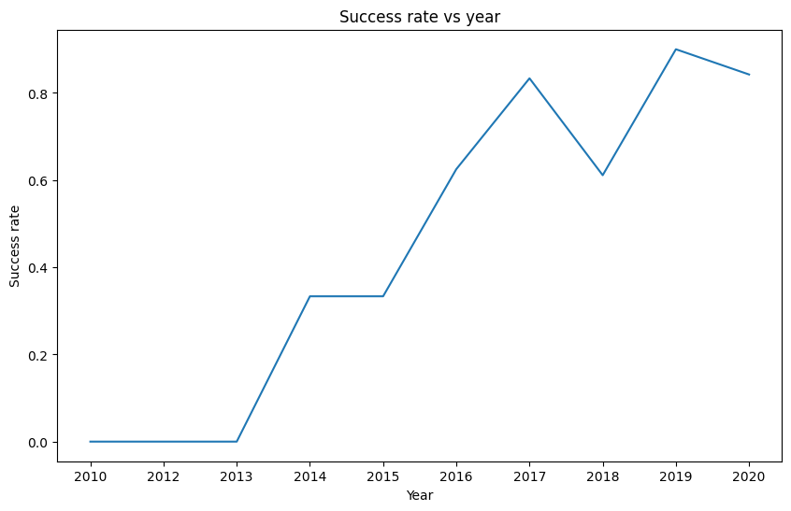
Launch Success Yearly Trend
The success rate improves over time, with the exception of 2018
A quick Google search indicates that it corresponds to problems with the hydraulic systems and the landing leg deployment.

Slide 25
All Launch Site Names
SQL query to select the names of the launch sites:
select distinct Launch_Site from SPACEXTABLE
There are four different launch sites
Launch site
CCAFS LC-40
VAFB SLC-4E
KSC LC-39A
CCAFS SLC-40

Slide 26
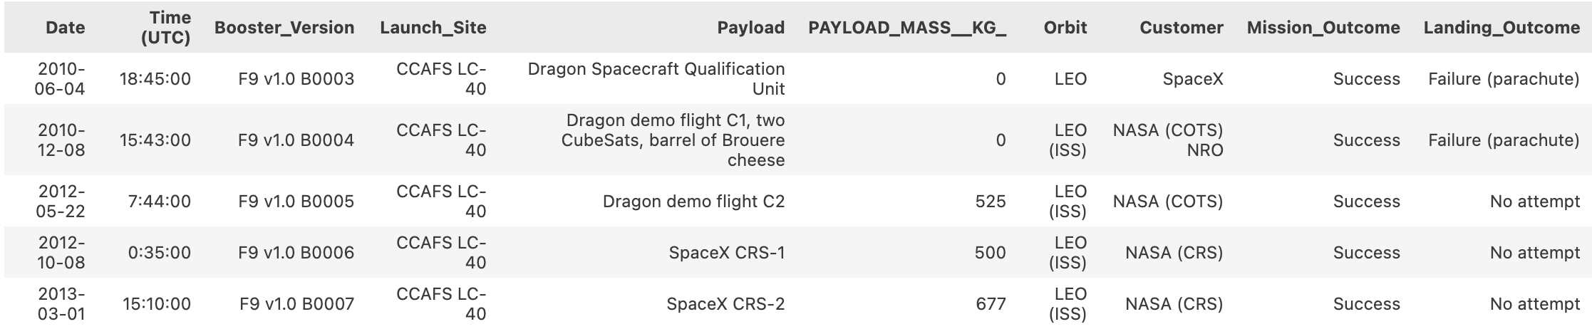
Launch Site Names Begin with 'CCA'
SQL query to select 5 records where launch sites begin with the string ‘CCA’:
select * from SPACEXTABLE where Launch_Site like '%CCA%' limit 5
We find the following records:

Slide 27
Total Payload Mass
SQL query to calculate the total payload carried by boosters from NASA (CRS)
select sum(PAYLOAD_MASS__KG_) from SPACEXTABLE where Customer like '%CRS%'
We find a total payload mass of 48213 Kg.

Slide 28
Average Payload Mass by F9 v1.1
SQL query to calculate the average payload mass carried by booster version F9 v1.1
select avg(PAYLOAD_MASS__KG_) from SPACEXTABLE where Booster_Version like '%F9 v1.1%’
We find an average payload mass of 2534.67 Kg.

Slide 29
First Successful Ground Landing Date
SQL query to find the dates of the first successful landing outcome on ground pad
select min(Date) from SPACEXTABLE where Landing_Outcome like '%Success (ground pad)%'
We find that the first successful landing outcome on ground pad was on 22/12/2015

Slide 30
Successful Drone Ship Landing with Payload between 4000 and 6000
SQL query to list the names of boosters which have successfully landed on drone ship and had payload mass greater than 4000 but less than 6000
select Booster_Version from SPACEXTABLE where Landing_Outcome like '%Success (drone ship)%' and PAYLOAD_MASS__KG_ BETWEEN 4000 and 6000
We find the following boosters:
Booster version
F9 FT B1022
F9 FT B1026
F9 FT B1021.2
F9 FT B1031.2

Slide 31
Total Number of Successful and Failure Mission Outcomes
SQL query to calculate the total number of successful and failure mission outcomes
select (select count(Landing_Outcome) from SPACEXTABLE where Landing_Outcome like '%Success%') as SuccessCount, (select count(Landing_Outcome) from SPACEXTABLE where Landing_Outcome like ‘%Failure%') as FailureCount
We find the following count:
Success | Failure
61 | 10

Slide 32
Boosters Carried Maximum Payload
SQL query to list the names of the booster which have carried the maximum payload mass
select Booster_Version from SPACEXTABLE where PAYLOAD_MASS__KG_ = (select max(PAYLOAD_MASS__KG_) from SPACEXTABLE)
We find the booster versions displayed in the table.
Booster version
F9 B5 B1048.4
F9 B5 B1049.4
F9 B5 B1051.3
F9 B5 B1056.4
F9 B5 B1048.5
F9 B5 B1051.4
F9 B5 B1049.5
F9 B5 B1060.2
F9 B5 B1058.3
F9 B5 B1051.6
F9 B5 B1060.3
F9 B5 B1049.7

Slide 33
2015 Launch Records
SQL query to list the failed landing_outcomes in drone ship, their booster versions, and launch site names for in year 2015
select substr(Date,6,2) as month, Landing_Outcome, Booster_Version, Launch_Site from SPACEXTABLE where substr(Date,0,5)='2015' and Landing_Outcome like '%Failure (drone ship)%'
We find that all failed landings in 2015 were launched from CCAFS LC-40 in a drone ship in January and April.
Month | Landing outcome | Booster version | Launch site
01 | Failure (drone ship) | F9 v1.1 B1012 | CCAFS LC-40
04 | Failure (drone ship) | F9 v1.1 B1015 | CCAFS LC-40

Slide 34
Rank Landing Outcomes Between 2010-06-04 and 2017-03-20
SQL query to rank the count of landing outcomes (such as Failure (drone ship) or Success (ground pad)) between the date 2010-06-04 and 2017-03-20, in descending order
select Landing_Outcome, count(Landing_Outcome) as count from SPACEXTABLE where Date between '2010-06-04' and '2017-02-20' group by Landing_Outcome order by count desc
We find that the higher number of counts corresponds to a launch without attempt to land, whereas the second higher count corresponds to both successful and failed drone ship landings.
The smaller count corresponds to failed landings with parachute, and precluded landings with drone ship.
Landing outcome | Count
No attempt | 9
Success (drone ship) | 5
Failure (drone ship) | 5
Success (ground pad) | 3
Controlled (ocean) | 3
Uncontrolled (ocean) | 2
Failure (parachute) | 2
Precluded (drone ship) | 1

Slide 35

Section 3

Slide 36
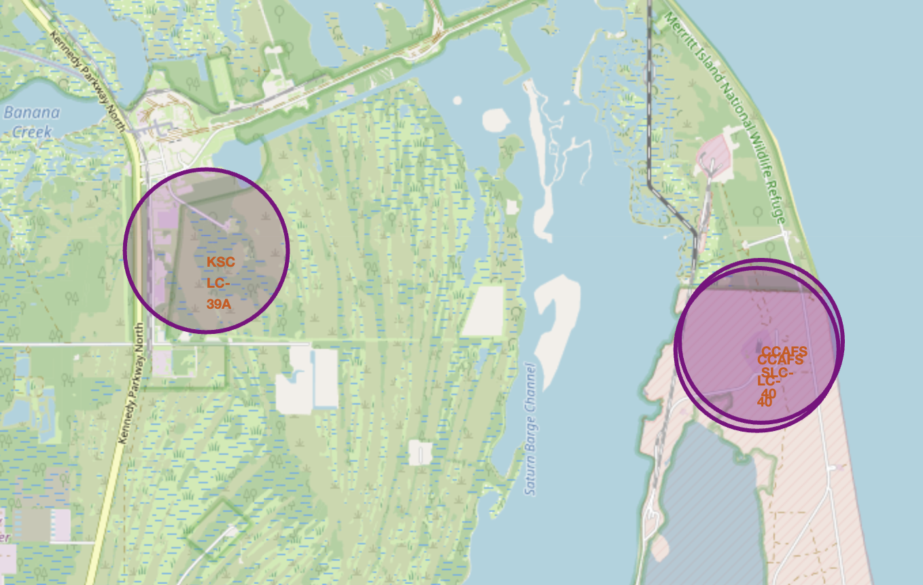
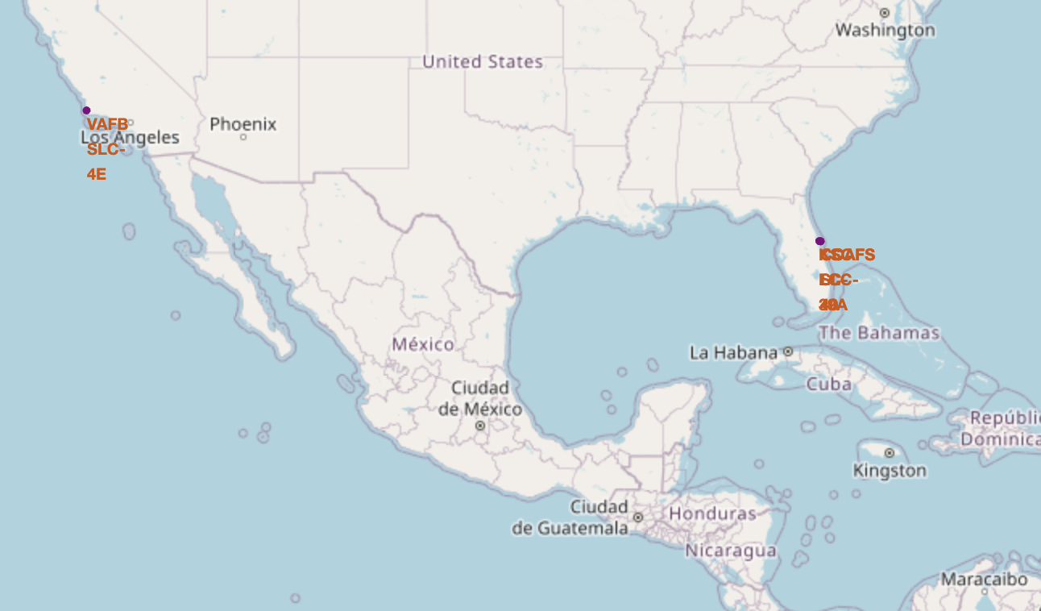
Locating the launch sites on the map
We circled the site locations and added markers to display their name

Slide 37
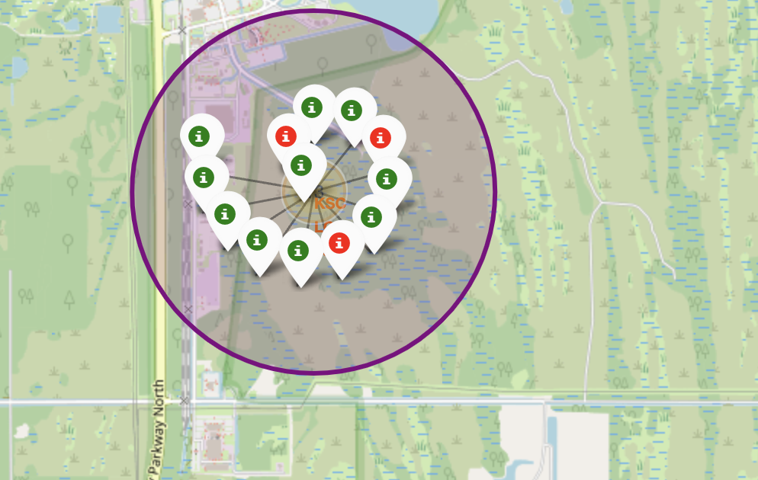
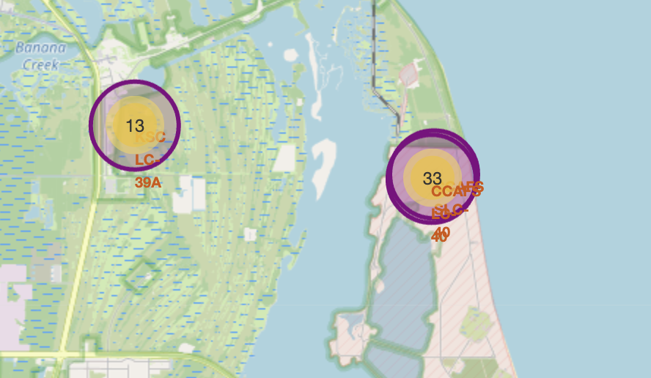
Displaying launch outcomes
We used a cluster of markers with their color displaying the outcome of the launch (success: green / failure: red).
The site with the most successful launches, as seen during the EDA, is KSC-LC 39-A

Slide 38
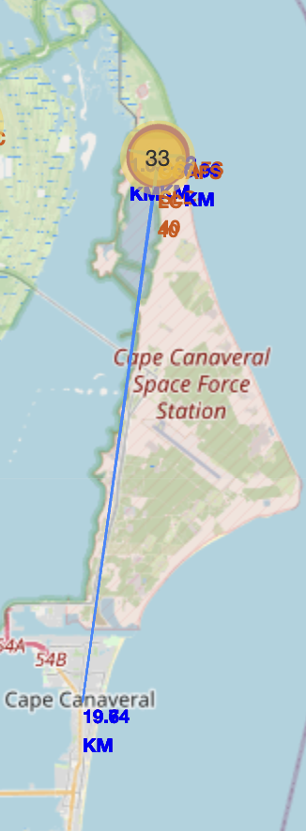
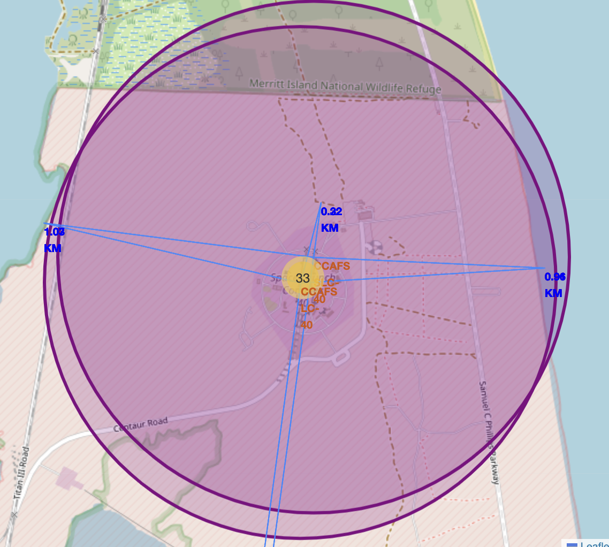
Proximity analysis
These particular sites are situated at the same distance from the coast from both sides.
They are also close to a rail, possibly used to transport the rockets.
Also, they are quite far from the city of Cape Canaveral, at around 20 Km.

Slide 39

Section 4

Slide 40
Building a dashboard: total success rate
Upon selecting ‘All sites’ in a dropdown element, in accordance with our EDA results, the most successful site is KSC LC-39A, followed by CCAFS SLC-40, VAFB SLC-4E, and CCAFS LC-40.

Slide 41
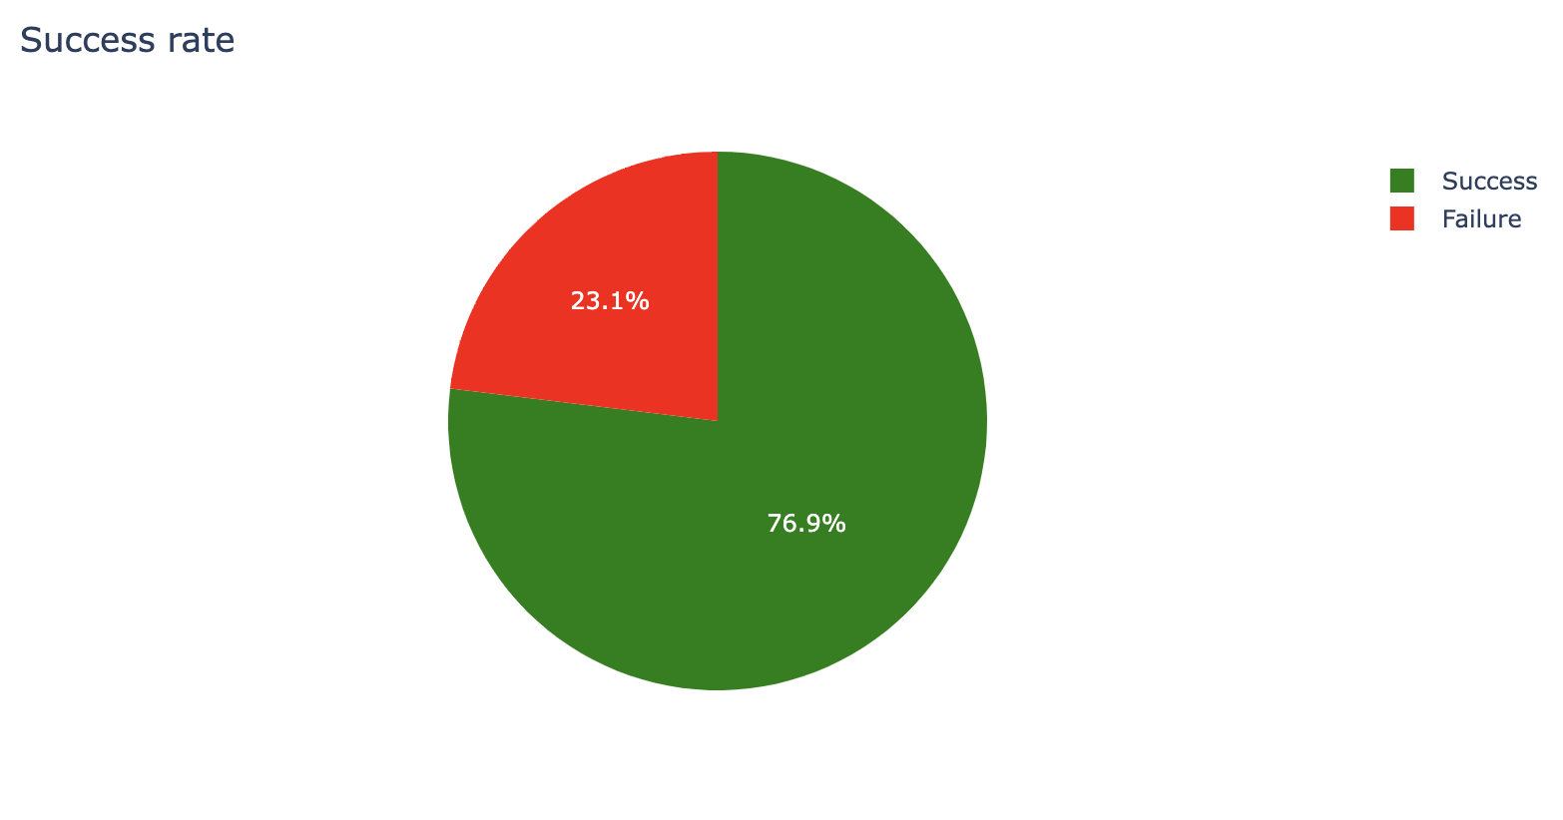
Building a dashboard: success rate per site
We focus on the most successful site, KSC LC-39A. As we can see, it has a 76.9% of successful landing, and a 23.1% of failed landings.

Slide 42
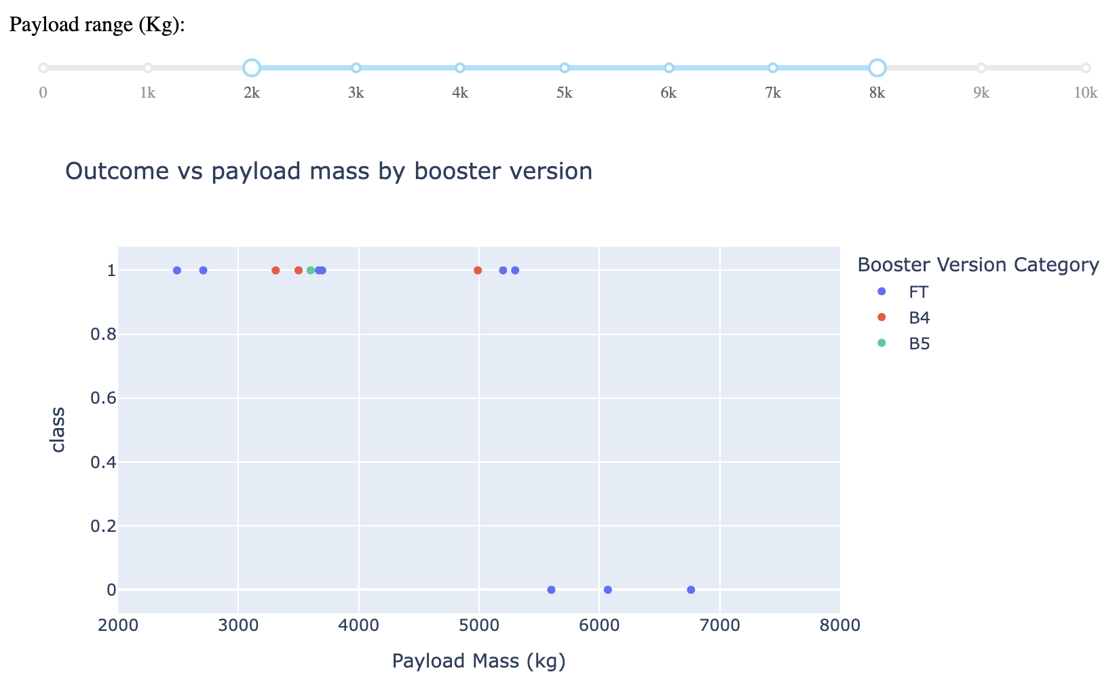
Building a dashboard: Outcome vs payload by booster version
Selecting a meaningful payload range using the slider, we can see that the FT booster version has mixed outcomes, although mostly positive.
The booster version B4 only has successful outcomes, and so does the B5, although having only one data point in the data set.

Slide 43

Section 5

Slide 44
Classification Accuracy
Visualize the built model accuracy for all built classification models, in a bar chart
Find which model has the highest classification accuracy

Slide 45
Confusion Matrix
Show the confusion matrix of the best performing model with an explanation

Slide 46
Conclusions
Point 1
Point 2
Point 3
Point 4
…

Slide 47
Appendix
Include any relevant assets like Python code snippets, SQL queries, charts, Notebook outputs, or data sets that you may have created during this project

Slide 48


